Slide 1
Physiology SEM IV
UNIT 46
Practical demonstration class Southern, Northern, Western and Dot blotting

Slide 2
What is the blotting technique?
Blotting techniques are what scientists use to separate these types of molecules. In cells, they exist as a mixture. ... Blotting is generally done by letting a mixture of DNA, RNA or protein flow through a slab of gel.

Slide 3
General Procedure for blotting
Homogenization of the sample which involves the purification of DNA/RNA/proteins which is performed after extraction from a variety of sources such as cells or tissue.
Digest the DNA with restriction enzymes into fragments, which is not required for RNA(northern blot).
Separation of the molecule of interest by an electrophoresis membrane generally on an agarose gel for DNA fragments. In the case of RNA samples they can be separated on an agarose gel in presence of formaldehyde as the denaturing agent. This is necessary as formaldehyde confines secondary structures of RNA molecules.
Transferring the molecules (DNA/RNA fragments) to a nitro cellulosic membrane/ nylon membrane from the gel.
Prehybridization (Blocking): Washing of the nylon membrane with a prehybridization or blocking solution in order to block non-specific DNA interactions and also this helps in the reduction of background noise. As an alternative, there are some commercially available blocking buffers loke PerfectHyb™ Plus buffer in which there is no requirement of salmon sperm DNA for blocking purpose.
For the preparation of probe fresh probe DNA labeled with ³²P alpha-labeled dCTP is prepared.
Hybridization or identification of the molecule which is achieved by incubating the blot with the specific labeled probe.
For the detection of the probe and the sequence of interest DNA/RNA the film is exposed to -80°C.

Slide 4
Western blotting
Western blotting is an important technique used in cell and molecular biology. By using a western blot, researchers are able to identify specific proteins from a complex mixture of proteins extracted from cells. The technique uses three elements to accomplish this task: (1) separation by size, (2) transfer to a solid support, and (3) marking target protein using a proper primary and secondary antibody to visualize.

Slide 5
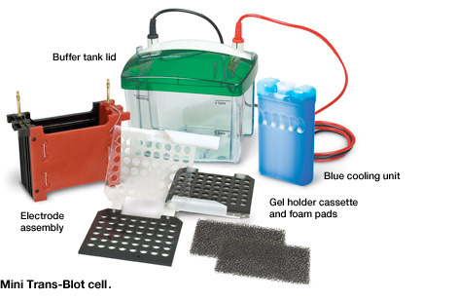

Slide 6
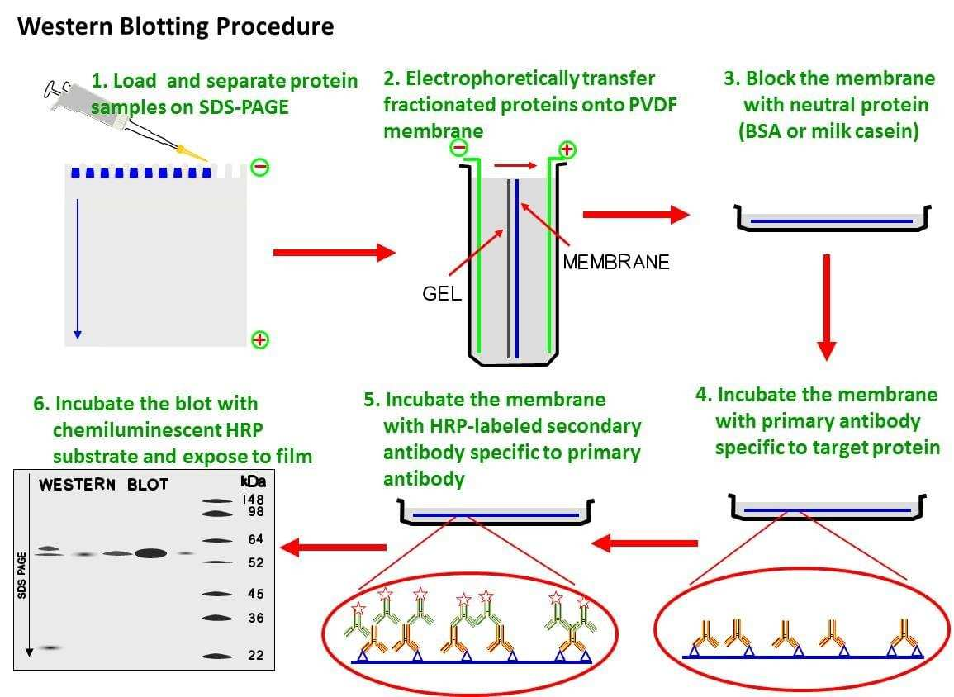

Slide 7
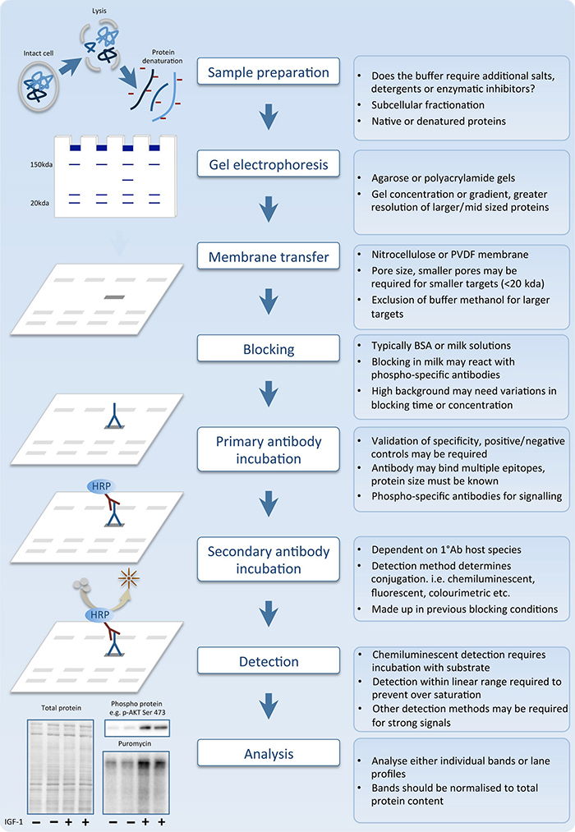

Slide 8
Protein can be extracted from different kind of samples, such as tissue or cells. Below is the protocol to extract proteins from adherent cells.
Wash cells in the tissue culture flask or dish by adding cold phosphate buffered saline (PBS) and rocking gently. Discard PBS. (Tip: Keep tissue culture dish on ice throughout).
Add PBS and use a cell scraper to dislodge the cells. Pipette the mixture into microcentrifuge tubes.
Centrifuge at 1500 RPM for 5 minutes and discard the supernatant.
Add 180 μL of ice cold cell lysis buffer with 20 μL fresh protease inhibitor cocktail. (Tip: If protein concentration is not high enough at the end, it is advised to repeat the procedure with a higher proportion of protease inhibitor cocktail).
Incubate for 30 minutes on ice, and then clarify the lysate by spinning for 10 minutes at 12,000 RPM, at 4°C.
Transfer supernatant (or protein mix) to a fresh tube and store on ice or frozen at -20°C or -80°C.
Measure the concentration of protein using a spectrophotometer.

Slide 9
Sample preparation
determine the volume of protein extract to ensure 50 μg in each well.
Add 5 μL sample buffer to the sample, and make the volume in each lane equalized using double distilled H₂O (dd H₂O). Mix well. (Tip: Total volume of 15 μL per lane is suggested).
Heat the samples with dry plate for 5 minutes at 100°C.

Slide 10
Some important terminology
What is a Primary Antibody?
The primary antibody is the one that binds directly to the antigen. The variable region of the primary antibody recognizes an epitope on the antigen. It is produced by a host organism that is of a different species than the specimen. The primary antibody usually does not contain a fluorophore or an enzyme, so the researcher cannot visualize the antigen without further reagents such as a secondary antibody.
What is a Secondary Antibody?
The secondary antibody binds to the primary antibody but not any antigen that is present in the specimen. Secondary antibodies bind to the heavy chains of primary antibodies, so that they don’t interfere with the primary antibody binding to the antigen. This secondary antibody is made in a species that is different than both those of the primary antibody or the specimen. This minimizes non-specific binding that leads to false positives and high background noise.

Slide 11
Why Use Two Antibodies?
An antibody may work very well for multiple applications, such as western blotting and immunofluorescence, but different assays have experimental conditions that require different methods of visualization. Using the same primary antibody in multiple different assays often requires a secondary antibody. The primary antibody detects the antigen in the specimen, but the secondary antibody can be designed to have a fluorophore or enzyme complex attached to it for the purposes of visualization.

Slide 19
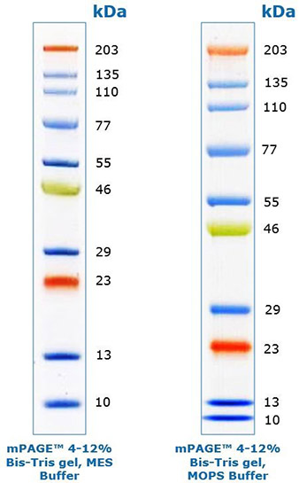
Molecular weight markers in western blotting
The purpose of a protein marker or ladder is to provide a reference of the size of proteins resolved in the gel electrophoresis.

Slide 20
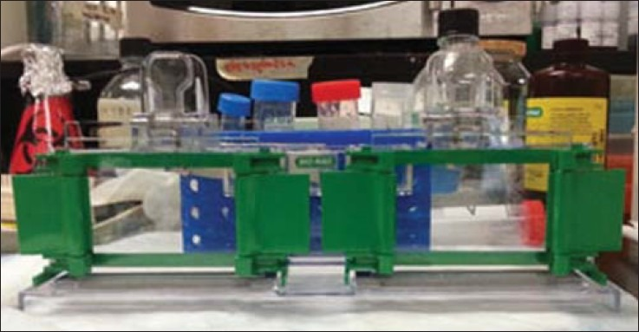
After preparing the 10% stacking gel solution, assemble the rack for gel solidification . (Tip: 10% AP and TEMED solidify the solution; therefore, both gels can be prepared at the same time, if the above mentioned reagents are not added until the end).

Slide 21
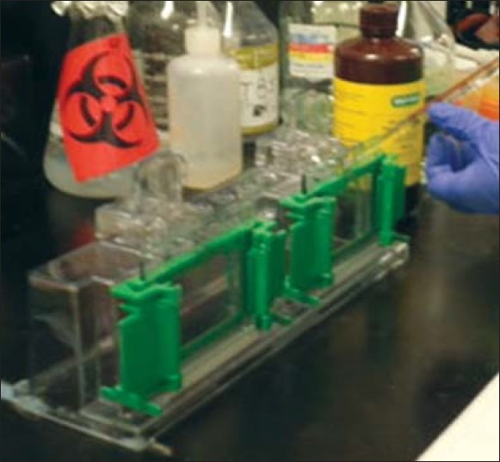
Add stacking gel solution carefully until the level is equal to the green bar holding the glass plates. Add H₂O to the top. Wait for 15–30 minutes until the gel turning solidified. (Tip: Using a suction pipette can make the process of adding the gel to the glass plate easier).

Slide 22
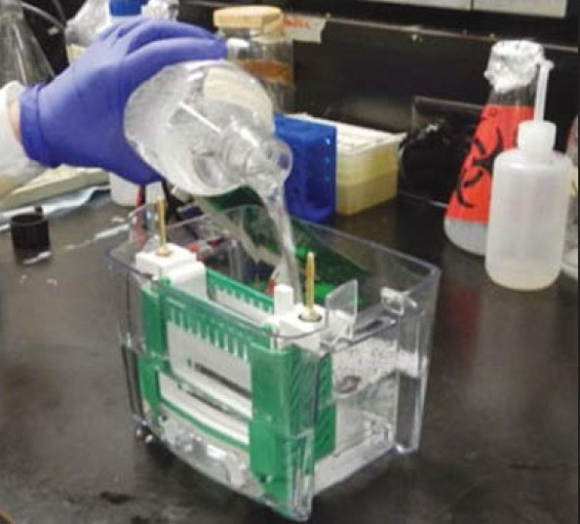
Overlay the stacking gel with the separating gel, after removing the water. (Tip: It is better to tilt the apparatus and use a paper towel to remove the water).
Insert the comb, ensuring that there are no air bubbles.
Wait until the gel is solidified. (Tip: Solidification can be easily checked by leaving some gel solution in a tube).
Electrophoresis
Pour the running buffer into the electrophorator [].

Slide 23
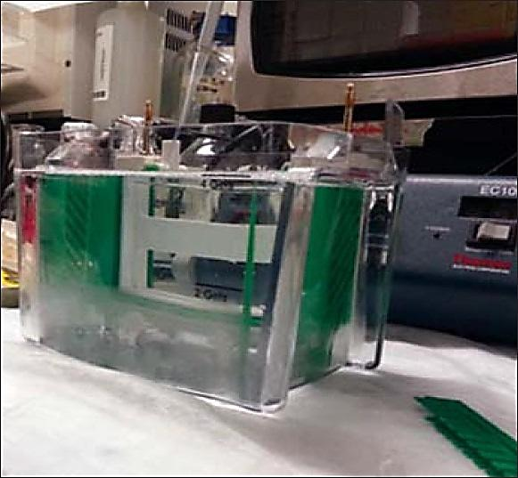
Place gel inside the electrophorator and connect to a power supply. (Tip: When connecting to the power source always connect red to red, and black to black).
Make sure buffer covers the gel completely, and remove the comb carefully.
Load marker (6 μL) followed by samples (15 μL) in to each well.

Slide 24
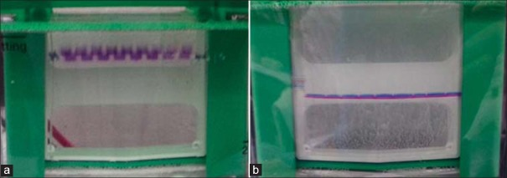
Run the gel with low voltage (60 V) for separating gel; use higher voltage (140 V) for stacking gel.

Slide 25
Run the gel for approximately an hour, or until the dye front runs off the bottom of the gel.
Run the gel to the bottom of the electrophorator Electrotransfer
Cut 6 filter sheets to fit the measurement of the gel, and one polyvinylidene fluoride (PDVF) membrane with the same dimensions.
Wet the sponge and filter paper in transfer buffer, and wet the PDVF membrane in methanol.
Separate glass plates and retrieve the gel.
Create a transfer sandwich as follows:
Sponge
3 Filter Papers
Gel PVDF
3 Filter Papers
(Tip: Ensure there are no air bubbles between the gel and PVDF membrane, and squeeze out extra liquid).
Relocate the sandwich to the transfer apparatus, which should be placed on ice to maintain 4°C. Add transfer buffer to the apparatus, and ensure that the sandwich is covered with the buffer. Place electrodes on top of the sandwich, ensuring that the PVDF membrane is between the gel and a positive electrode .

Slide 26
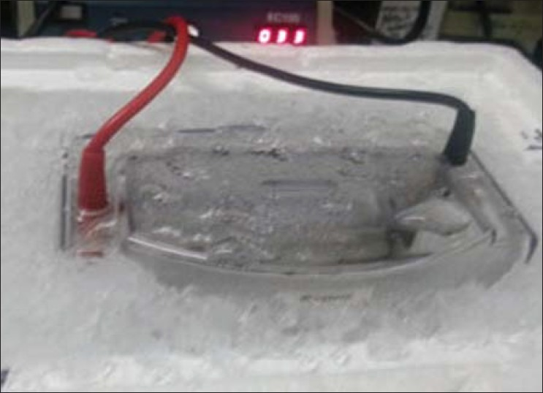

Slide 27
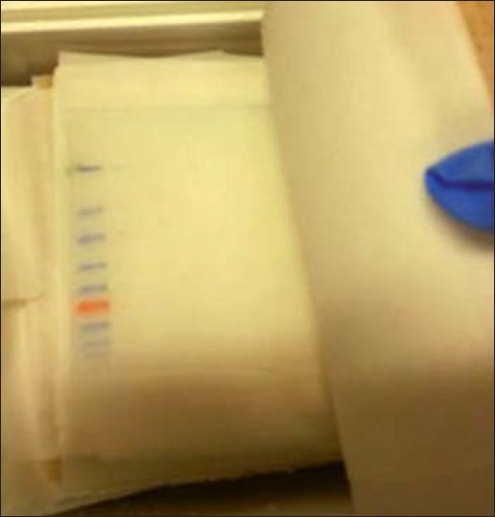
locking and antibody incubation
Block the membrane with 5% skim milk in TBST* for 1 hour.
Add primary antibody in 5% bovine serum albumin ( BSA) and incubate overnight in 4°C on a shaker.

Slide 28
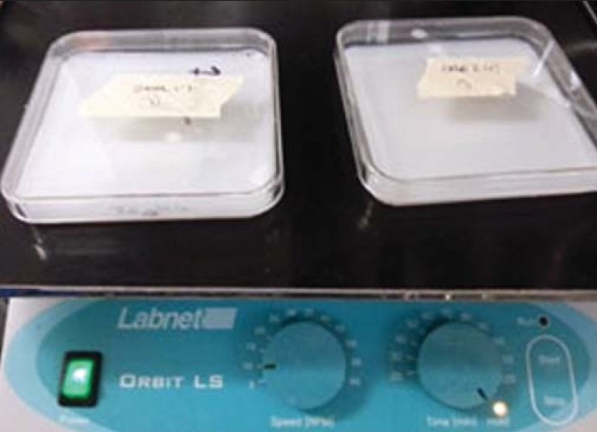
Shaking process

Slide 29
Wash the membrane with TBST for 5 minutes. Do this 3 times. (Tip: All washing and antibody incubation steps should be done on a shaker at room temperature to ensure even agitation).
Add secondary antibody in 5% skim milk in TBST, and incubate for 1 hour.
Wash the membrane with TBST for 5 minutes. Do this 3 times
Prepare ECL mix (following the proportion of solution A and B provided by the manufacturer). Incubate the membrane for 1–2 minutes . (Tip: Use a 1000 μL pipette to ensure that ECL covers the top and bottom of the membrane).

Slide 30
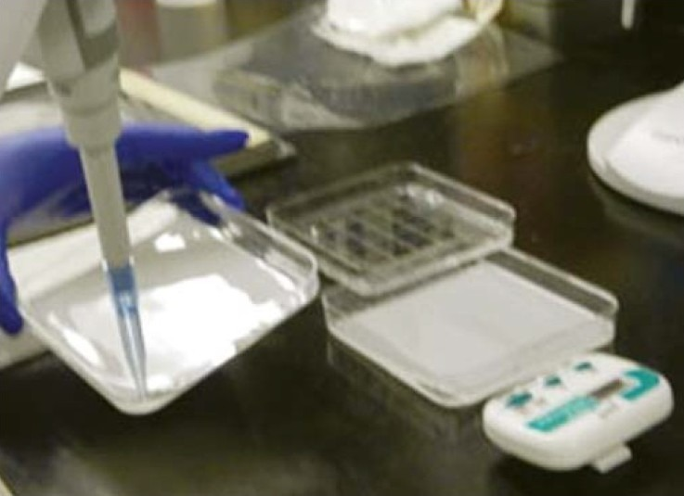
Incubate the membrane with ECL mix using a 1000 μL pipette to help the process
Visualize the result in the dark room. (Tip: If the background is too strong, reduce exposure time).

Slide 31
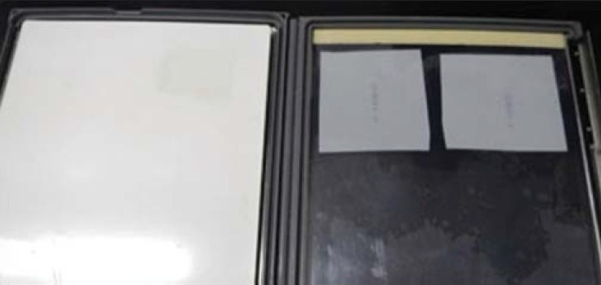

Slide 32
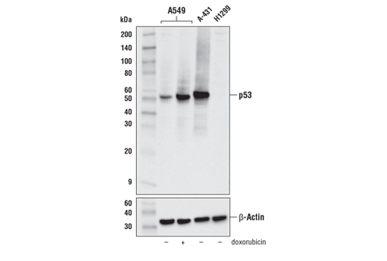

Slide 33
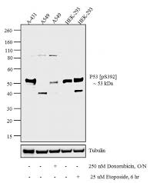

Slide 34
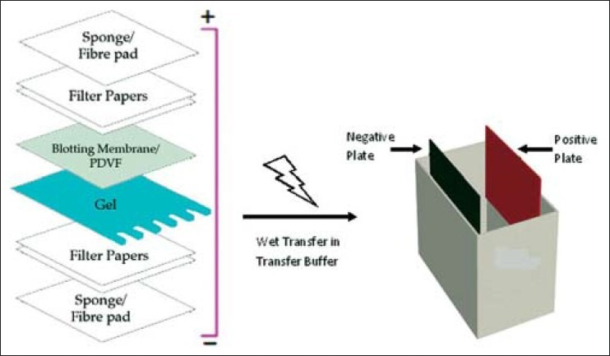

Slide 35
Northern blot procedure
To measure the size and amount of RNA transcribe from a specific gene of interest.

Slide 36
Northern blot
Northern blot first uses denaturing gel to separate RNA according to the size. The RNA is then transferred to a nylon membrane while keeping the same distribution in the gel. After fixing the RNA to the membrane, labeled probe complementary to the gene of interest is then added to hybridize to the immobilized RNA. The nonspecifically bound probes are then washed away. The solid membrane with probe specifically bound to RNA of interest is then dried, exposed and analyzed. Since northern blot uses size-dependent separation, this technique can not only determine the abundance but also the sizes of transcript of interest. It can be a very effective way to detect transcript variants of genes. However, if the amount of total RNA for the experiment is limited and expression level of transcript of interest is low, other techniques more sensitive than northern blot, such as quantitative RT-PCR, can be used.

Slide 37
RNA extraction
A general blotting procedure starts with extraction of total RNA from a homogenized tissue sample or from cells. Eukaryotic mRNA can then be isolated through the use of oligo (dT) cellulose chromatography to isolate only those RNAs with a poly(A) tail. RNA samples are then separated by gel electrophoresis. Since the gels are fragile and the probes are unable to enter the matrix, the RNA samples, now separated by size, are transferred to a nylon membrane through a capillary or vacuum blotting system.

Slide 38
Separating RNA Samples on an Agarose Gel
Prepare a 1% × 2% agarose gel: Melt 1.0 g agarose in 84.6ml DEPC water and boil in a microwave. Let it cool down to 60°C, and add 10ml of 10 x MOPS buffer and 5.4ml 37% formaldehyde (total 2% (vol/vol))and fill the apparatus. Insert the comb and solidify for 30minutes.
Mix at least 10 μg total RNA with Loading Buffer (1:1).
Denature the RNA/Loading Buffer mixtures at 65°C for 10 min. Immediately chill the denatured samples on ice for 1 min.
Load the samples and RNA markers onto a dry gel. Fill the slot carefully with running buffer (1× MOPS buffer) only up to the top of the gel (but not over the sample slots).
Run the gel at a higher voltage (i.e., >34 V/cm) for about 10 min to get the samples into the gel. Then add extra running buffer to submerge the gel completely.
Run the gel at 34 V/cm for at least 2 h, until the RNAs are well separated. "

Slide 39
Transferring RNA to a Membrane (Capillary Transfer Method)
After the electrophoresis, soak the gel twice (2 × 15 min) in 20× SSC to remove formaldehyde (which can inhibit transfer).
Set up a blot transfer as follows, roll a sterile pipette over the sandwich to remove all air bubbles that formed between any two parts of the blot “sandwich”:  Place a piece of Whatman 3MM paper that has been soaked with 20× SSC atop a “bridge” that rests in a shallow reservoir of 20× SSC.
Place gel, facing down, on top of the soaked sheet of Whatman 3MM paper.
Cut a piece of Positively Charged Nylon Membrane to the size of the gel and place the dry membrane carefully on top of the gel.
Complete the blot assembly by adding two dry sheets of Whatman 3MM paper, cut to the size of the gel, a stack of paper towels, a glass plate, and a 200 – 500 g weight.
Let the RNA transfer (at least 6 h, preferably overnight) under RNase-free conditions, with sterile, RNase-free 20× SSC as transfer buffer.
The next day, disassemble the transfer stack. Place the membrane (RNA side facing up) on Whatman 3MM paper that has been soaked in 2× SSC.
Expose the wet membrane to UV stratalinker at 120 mJ/cm² for 1 minutes to fix the RNA to the blot.

Slide 40
Prehybridizing and Hybridizing the Blot
Place the correct amount of DIG Easy Hyb (about 10-15ml for 100cm² membrane) in a sterile tube, then place the tube in a water bath set at 50°C.
Place the blot into DIG Easy Hyb and incubate the blot for 30 minutes at 50°C.
During the prehybridization incubation, prepare the hybridization solution with 5’Dig-labeled DNA probe (final concentration: 20-50ng/ml or 1.5-4nM) in prewarmed DIG Easy Hyb.
Pour out the prehybridization buffer and immediately replace with prewarmed hybridization solution containing DIG-labeled probe.
Incubate the blot with probe at 50°C for 6 – 16 h, with gentle agitation. Tips: the hybridizing temperature can be optimized to your own target RNA. For example, to get the best result of mir-142-5p, we hybridized the blot at 42°C overnight.

Slide 41
Strict washes
After the hybridization is complete, submerge the membrane in an RNase-free plastic container (tray, dish, etc.) tray containing Low Stringency Buffer (2× SSC containing 0.1% SDS).
Incubate the tray at room temperature for 5 min with shaking.
Pour off the used buffer and immediately cover the membrane with fresh Low Stringency Buffer.
Incubate the tray an additional 5 min at room temperature with shaking. During the process, preheat High Stringency Buffer(0.1× SSC containing 0.1% SDS) to 50°C.
Pour off the used Low Stringency Buffer. Immediately add the preheated High Stringency Buffer to the tray containing the blot.
Incubate the blot twice (2 × 15 min, with shaking) in High Stringency Buffer at 50°C.

Slide 42
Chemiluminescent Methods for Detection of Probes on a Blot
Transfer the membrane to a plastic container containing enough Washing Buffer and incubate for 2 min at room temperature, with shaking.
Discard the Washing Buffer and add enough Blocking Solution to tray.
Incubate membrane for 30 min at room temperature, with shaking. This blocking step can last up to 3 hours without affecting results.
Discard the Blocking Solution and add 20 ml Anti-Digoxigenin-AP Solution to the tray. Incubate the membrane for 30 min, with shaking.
Discard the Antibody Solution.
Wash membrane twice (2 × 15 min) with enough Washing Buffer.
Equilibrate membrane 3 min in Detection Buffer.
Place the membrane (DNA/RNA side facing up) inside a container. Apply enough CSPD working solution over the surface of the blot until the entire surface is evenly soaked.
Incubate membrane for 5 min at room temperature.
Incubate damp membrane for 10 min at 37°C to enhance the luminescence reaction.
Expose the sealed envelope (containing the membrane) at room temperature to Lumi-Film X-ray film (15 – 25 min) and adjust the exposure time to get a darker or lighter band pattern.

Slide 43
Techniques for Stripping and Reprobing a Membrane
After detection of the first target on the membrane, rinse membrane thoroughly with double distilled water for 1 min.
Wash membrane twice (2 × 15 min) at 37°C in Stripping Buffer.
Rinse membrane in 2× SSC for 5 min.
Reprobe membrane with a second DIG-labeled probe: repeat the hybridization and detection procedure with a different DIG-labeled probe.

Slide 45
Southern Blotting
The first of these techniques developed was the Southern blot, named after Dr. Edwin Southern who developed it to identify specific DNA sequences. Southern blotting is a detection technique used to find the target DNA sequences in the DNA sample in the field of molecular biology. The process starts from electrophoresis of DNA molecules which are hybridized in a blotting membrane followed by a transfer step where DNA from gel is transferred onto the blotting membrane.

Slide 46
Principle
Restriction endonucleases, which is an enzyme, is used to break the DNA into small fragments. These fragments are then separated using electrophoresis. The fragments achieved is then classified according to their size (kDa). Thus, DNA fragments are transferred to the blotting paper where it is incubated with probes. Probes used in the Southern blotting can be highly selective. They can selectively bind with a resolution of 1 in a million and the characteristics to bind to the intended target fragments.

Slide 47
Materials Required
Reagents
The buffer used for electrophoresis is TAE or TBE.
The agarose preferred should be of electrophoresis grade.
For staining the DNA, ethidium bromide (0.5 µg ml–1, dissolved in H₂O) is used. But there are other DNA staining dyes such as SYBR green which can replace ethidium bromide for safe handling.
Note: Ethidium bromide being a mutagen requires careful handling. It is advised to wear gloves during its usage and follow the pertinent regulations for disposal of pipette tips. Avoid touching any objects with ethidium bromide contaminated gloves.
2Xand 20X SSC (the composition of 20X SSC includes 3.0 M NaCl and 0.3 M sodium citrate)
6X DNA loading buffer composed of 0.25% bromophenol blue, 0.25% xylene cyanol FF and 30% glycerol in water.
Suitable DNA markers of varying molecular weight also referred to as DNA ladders are used as standards for reference.
The prehybridization and hybridization mixture consists of 0.5% SDS, 6X SSC, 5X Denhardt’s solution and 100 mg ml^{–1} sheared, denatured salmon sperm DNA or yeast tRNA.
Denhardt’s solution widely used for hybridization is made up of 0.02% Ficoll, 0.02% polyvinylpyrrolidone and 0.02% bovine serum albumin (BSA)
Paraffin oil

Slide 48
Reagent Set up
DNA: The entire procedure is initiated by employing enzyme digested DNA of varying concentrations which will quantify the optimum DNA concentration and specify restriction enzyme to be used. Generally, an amount of 1 µg of DNA derived from clones (e.g. from plasmid or bacteriophage clones) is adequate enough for plasmids having low-copy-number. We require larger amounts for carrying out the separation of complex DNA (e.g. genomic DNA). The advisable range to be considered would be 5–10 µg.
The electrophoresis buffer used is TAE which has a composition of 40 mM Tris, 20 mM acetic acid, 1 mM EDTA with pH range of 7.4–8.2 which is normally made as stock concentration of 20X or TBE made up of 89 mM Tris, 2.5 mM EDTA, 89 mM borate, normally made as a 10 × stock).
TAE is recommended to be best when we run gels for a shorter interval of time and when the recovery of DNA fragments from gel is to be carried out.
TBE is considered to be a better buffer especially when we have to run the gels for a time period exceeding 2 h.

Slide 49
Step 1: DNA purification
To extract the DNA present inside the nucleus of a cell, we must first lyse the entire cell to enable the expulsion of the DNA. Incubating the cell culture with detergent lyses the entire cell. Now the lysed sample contains DNA, protein, and debris. Protein is lysed by adding the proteinase enzyme and incubated. DNA is purified and separated by alcohol precipitation and fibers are removed by using a buffer.
Apart from standard manual isolation procedures, there are commercially available kits like GenElute™ for the isolation of DNA from a variety of sources such as mammalian cells, plants, bacteria, fungi. High purity of the isolated DNA is ensured in case of use of commercial kits.

Slide 50
Step 2: Fragmentation
The long nucleotide sequences should be broken into smaller fragments for the purification or identification process. This is done by the restriction endonuclease enzyme.
All the reagent necessary for the digestion process should be kept on ice before setting up a restriction digestion reaction with suitable enzyme and appropriate DNA concentration. The components are added to the multiwell plates or microcentrifuge tubes (PCR tubes) and mixed by aspirating the contents with the help of a pipette slowly to avoid formation of any bubbles. It is to be taken care that the enzyme has to be added at the last step and until then it should be stored at −20 °C. To ensure complete digestion of the DNA a surplus amount of enzyme is supposed to be added as the fragments produced due to partial digestion can cause ambiguity in the results leading to inaccurate analysis of the subsequent blot to be analysed. Nevertheless, the concentration of the enzyme added in total should not surpass one-tenth of the total volume of the digest, because the glycerol content generally found in stock of the enzymes has the capacity to impede digestion process when present at high concentration. Also, inorder to minimize the probable errors due to pipetting master mixes should be prepared accordingly when there is a requirement of analysis of a large number of samples.

Slide 51
Step 3: Gel Electrophoresis
Nucleic acids are negatively charged molecules. So they move towards the anode in an electrophoresis chamber. The movement of the DNA fragments differentiates the rate of the transport thus enabling the separation by size.

Slide 52
Step 4: Denaturation
DNA thus attained are double stranded in nature. For our purpose of probe hybridization, we need a single stranded DNA. DNA is therefore denatured in an alkaline solution. This results in the formation of denatured DNA.

Slide 53
Step 6: Hybridization
Labeled probe is added to the membrane buffer and incubated for as It takes several hours for the probe to find the exact target sequence.
The time required for hybridization usually 1–16 h depends on factors like complexity of the probe and concentration
The radioactive RNAs are present in limited amount as it is derived from cells making it an important factor for the original protocol. Due to this the volume of the hybridisation solution used is supposed to be less so that the desired RNA concentration can be achieved. There can be two approaches for hybridisation experiment where one uses smaller volume and the other utilizes a vessel destined to hold the membrane in low volume of liquid. The suitable set up possess a plastic bag that can be sealed using heat and it consists of optimum amount of hybridisation mix and can be dipped in a water bath or a hybridisation tube with capped ends. In case of the tube it must be ensured that the membrane is wet when the tube is subjected to rotation cycles in a rotisserie oven. The probes applied can be either RNA or DNA. The cells act as a source for the RNA or alternatively, they can also be obtained from clones or PCR products via in vitro transcription In case of DNA they can be either clones or PCR products. The procedure adopted for the labeling method relies on the on the source from which the probe is derived.

Slide 54
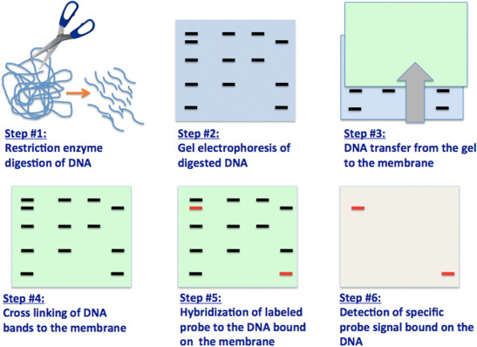

Slide 55
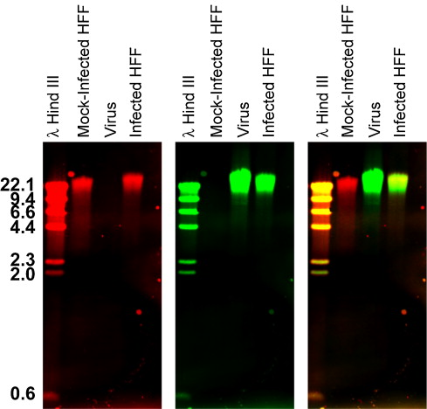

Slide 56
Dot Blots
A Simple Yet Effective Detection Method
Dot blots are very similar to Western blots in that they involve the use of antibodies to identify a protein that has bound to a membrane. However, they do not require electrophoretic protein separation on a gel as the test sample is simply spotted on to the membrane and then detected.
Due to the lack of a protein separation step, dot blots cannot be used to determine the molecular weight of a protein or to discriminate between different protein forms (e.g. cleaved or phosphorylated proteins). Instead dot blots are convenient for estimating the protein concentration in crude preparations such as tissue culture supernatant or ascites, for determining whether an antibody based detection system will work effectively, or to identify an appropriate antibody concentration for Western blotting.

Slide 57
The Main Steps of a Traditional Dot Blot Assay are as follows
The protein is spotted on to a nitrocellulose or PVDF membrane, for example using a low-volume pipette or a pin tool
The membrane is blocked
Incubation with primary antibody
The membrane is washed to remove unbound antibody
Incubation with secondary antibody
The membrane is washed to remove unbound antibody
Detection – Usually colorimetric, fluorometric, chemiluminescent or using gold nanoparticles.
The use of directly labeled antibodies removes the need to carry out steps 5 and 6, significantly decreasing assay time and potentially reducing nonspecific binding and any associated background staining. Direct antibody labeling is discussed in further detail at the end of this application note.

Slide 58
Use of Dot Blots to Estimate Protein Concentration
Through spotting a purified protein in a series of known concentrations on to a membrane, a dot blot can be used to estimate the concentration of a target protein in a test sample. The concentration of protein in the test sample can be extrapolated from the serial dilution of purified protein.

